Slide 1
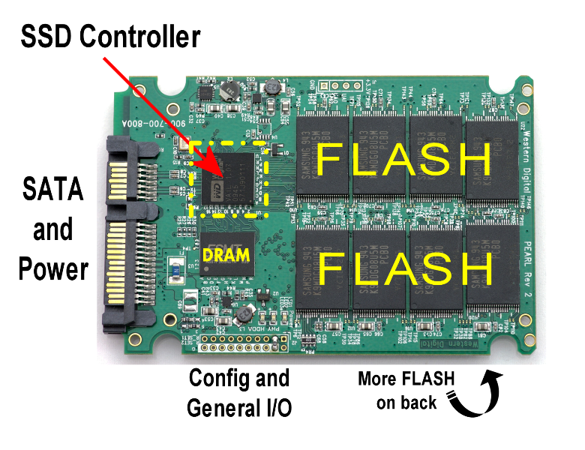
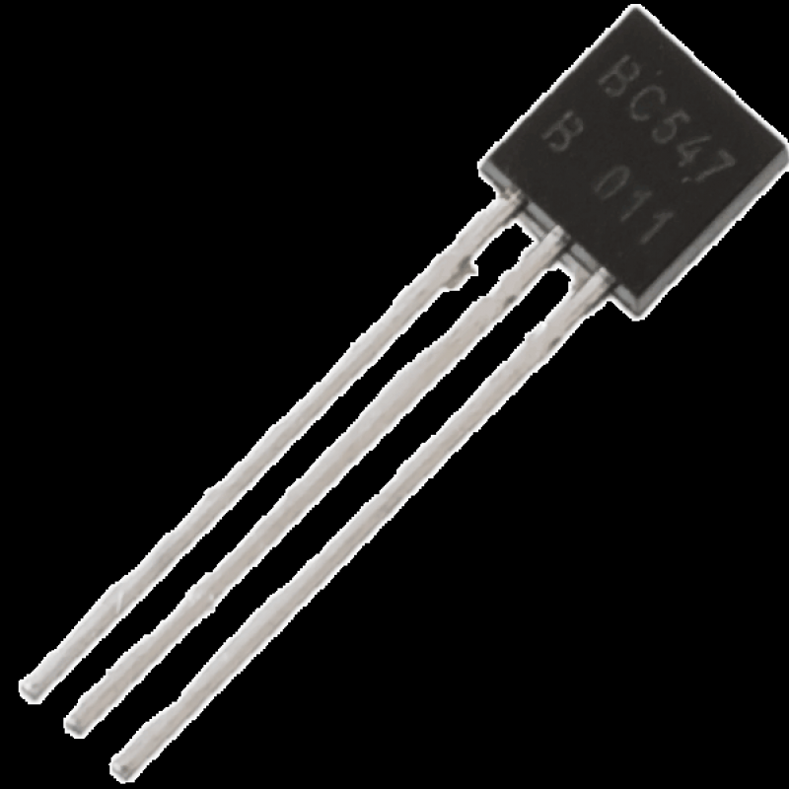
CHIP CONTROLLER:
flash NAND
Bán dẫn (transitor).

Slide 2
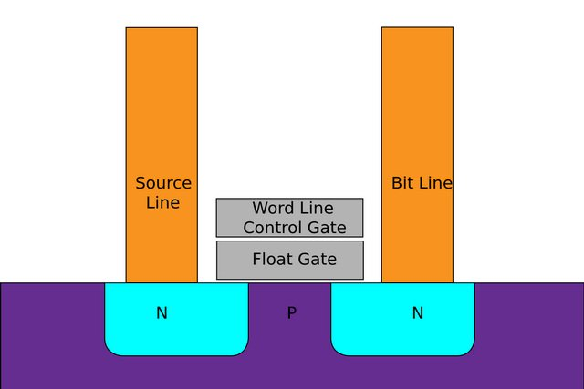
How it work?

Slide 3
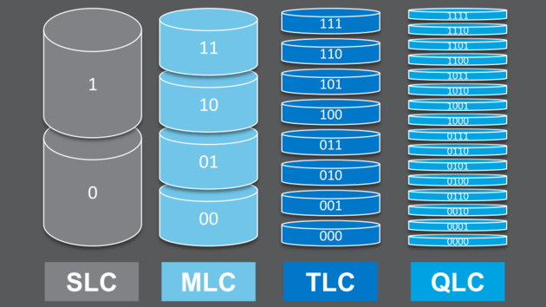
NAND TLC slower than MLC and SLC because of its storage of bits.

Slide 4


3 differences among SLC, MLC, TLC:
The data bit density contained in the memory chip.
Latency
Durability are based on the erase cycle (P / E cycle).

Slide 5
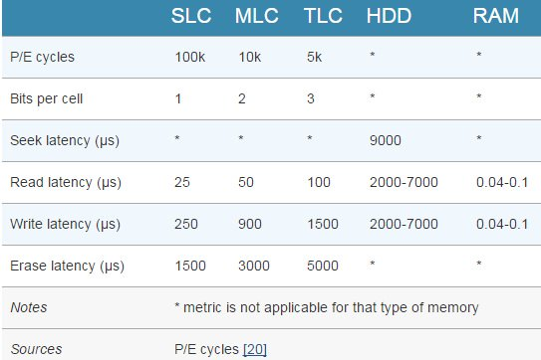
COMPARE: SLC-MLC-TLC.

Slide 6


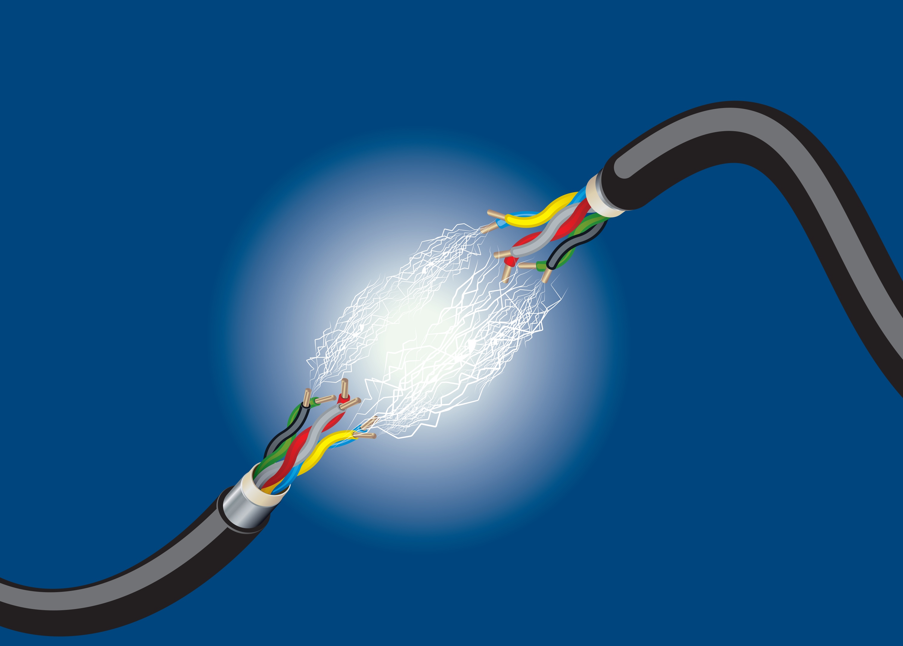
3 Things to make sure for NAND MLC and TLC
Electrons load correctly.
Accuracy.
Load status stability.

Slide 7



SSD ISN’T PERFECT
Evaporation of data.
Delete - not always safe.

Slide 8





How to protect data on SSD without risk
Destroying SSDs by physical means.
No Self-Encrypting Drive (SED).
Override SSD with professional erase software.
Make the remaining data encrypted and inaccessible.

